Slide 1
Spring Framework
Day 1

Slide 2
what is a Framework?
The framework is a re-usable design platform for software systems, which provides support for code libraries and various scripting languages.
In simple words a framework is something that makes core programming easy.
There are frameworks for PHP, Perl, Java, Python, Ruby, and many other languages.

Slide 3

What is Spring Framework?
Spring is a lightweight, loosely coupled and integrated frameworks for developing java enterprise applications.
Spring is a lightweight application framework and we can say it is similar to the framework of frameworks.
Because it provides support to various frameworks such as Struts, JSP, Hibernate, etc.

Slide 4
Advantages of Spring Framework
There are many advantages of Spring Framework.
Predefined Templates
Loose Coupling
Easy to test
Lightweight
Fast Development
Powerful abstraction
Declarative support

Slide 5
Predefined Templates
Spring framework provides templates for JDBC, Hibernate, JPA etc. technologies.
So there is no need to write too much code.
Loose Coupling
The Spring applications are loosely coupled because of dependency injection.
Easy to test
The Dependency Injection makes easier to test the application

Slide 6
Light weight
Spring framework is lightweight because of its POJO implementation. The Spring Framework doesn't force the programmer to inherit any class or implement any interface.
Fast Development
The Dependency Injection feature of Spring Framework and it support to various frameworks makes the easy development of JavaEE application.
Powerful abstraction
It provides powerful abstraction to JavaEE specifications such as JMS,JDBC, JPA and JTA.
Declarative support
It provides declarative support for caching, validation, transactions and formatting.

Slide 7
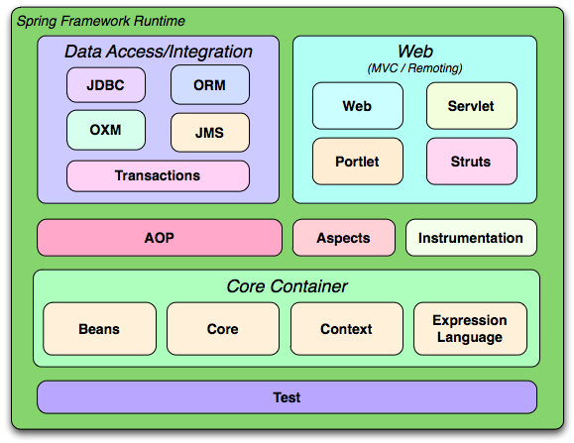
Spring Modules
The Spring framework comprises of many modules such as core, beans, context, expression language, AOP, Aspects, Instrumentation, JDBC, ORM, OXM, JMS, Transaction, Web, Servlet, Struts etc.

Slide 8
Spring Core Container :
The Spring Core container contains
Core
beans
context
expressionlanguage (EL) modules.

Slide 9
Core and Beans
These modules provide IOC and Dependency Injection features.
Context
This module supports internationalization (I18N), EJB, JMS, Basic Remoting.
Expression Language
It is an extension to the EL defined in JSP.
It provides support to setting and getting property values, method invocation, accessing collections and indexers, named variables, logical and arithmetic operators, retrieval of objects by name etc.

Slide 10
AOP, Aspects and Instrumentation
These modules support aspect oriented programming implementation where we can use Advices, Pointcuts etc. to decouple the code.
The aspects module provides support to integration with AspectJ.
The instrumentation module provides support to class instrumentation and class loader implementations.
Test
This layer provides support of testing with JUnit and TestNG.

Slide 11
Data Access / Integration
This group comprises of JDBC, ORM, OXM, JMS and Transaction modules.
These modules basically provide support to interact with the database.
Web
This group comprises of Web, Web-Servlet, Web-Struts and Web-Portlet.
These modules provide support to create web application

Slide 12
Spring Framework
Day 2

Slide 13
What is Dependency Injection ?
Injecting Dependence of an object from outside is known as Dependency Injection.
Spring framework provides two ways to inject dependency
By Constructor
By Setter method

Slide 14
Difference between constructor and setter injection :
Partial Dependency:
can be injected using setter injection but it is not possible by constructor. Suppose there are 3 properties in a class, having 3 arg constructor and setters methods. In such case, if you want to pass information for only one property, it is possible by setter method only.
Overriding:
Setter injection overrides the constructor injection. If we use both constructor and setter injection, IOC container will use the setter injection.
Changes:
We can easily change the value by setter injection. It doesn't create a new bean instance always like constructor. So setter injection is flexible than constructor injection.

Slide 15
Auto-wiring in Spring :
Auto-wiring feature of spring framework enables you to inject the object dependency implicitly.
It internally uses setter or constructor injection.
Auto-wiring can't be used to inject primitive and string values. It works with reference only.

Slide 16
Advantage of Auto-wiring:
It requires the less code because we don't need to write the code to inject the dependency explicitly.
Disadvantage of Auto-wiring:
No control of programmer.
It can't be used for primitive and string values.

Slide 17
IoC Container
The IoC container is responsible to instantiate, configure and assemble the objects.
The IoC container gets information from the XML or Annotations.
There are two types of IoC containers.
Bean Factory
Application Context

Slide 18
Bean Factory is the basic container.
Resource resourse = new ClassPathResource("applicationContext.xml");
BeanFactory factory = new XmlBeanFactory(resource);
Application context is the advanced container. Applicationcontext extends the bean factory interface.
ApplicationContext context =new ClassPathXmlApplicationContext("applicationContext.xml");

Slide 19
The main tasks performed by IoC container are:
To instantiate the application class
To configure the object
To assemble the dependencies between the objects

Slide 20
Hands-on
Constructor Dependency hands-on videos:
Video link : https://youtu.be/LC7S-uirjUQ
Video link : https://youtu.be/UNc47-ncB18
Setter Dependency hands-on videos:
Video link : https://youtu.be/yUp0hBVZ7Z0
Video link : https://youtu.be/k6UAAjZfbXY
Auto-wiring :
Video link : https://youtu.be/-E4Y8CuNgWc

Slide 21
Spring Boot Framework
Day 3

Slide 22

What is Spring Boot Framework?
Spring Boot makes it easy to create stand-alone, production-grade Spring based Applications. It’s a Java-based framework.
It offers a number of plug-ins.
It provides production-ready features such as metrics, health checks, and externalized configuration.
There is no requirement for XML configuration.

Slide 23
All kinds of applications can be designed using spring boot.
For web applications, spring boot provides built-in web servers (tomcat).
Many things are auto-configured.
Each application can have its own server.

Slide 24
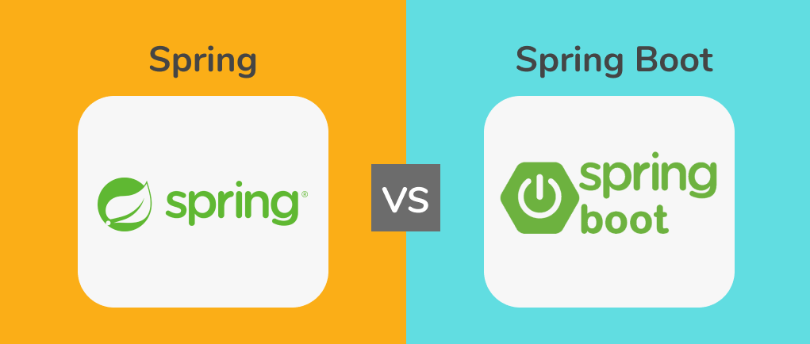

Slide 26
Basis | Spring | Spring Boot
Where it’s used? | Spring framework is a java EE framework that is used to build applications. | Spring Boot framework is mainly used to develop REST API’s
Why it’s used | Its goal is to make Java EE (Enterprise Edition) development easier, allowing developers to be more productive. | Spring Boot provides the RAD(Rapid Application Development) feature to the Spring framework for faster application development.
Type of Application Development | Spring framework helps to create a loosely coupled application. | Spring Boot helps to create a stand-alone application.
Servers dependency | In the Spring framework to test the Spring Project, we need to set up the servers explicitly. | Spring Boot offers built-in or embedded servers such as Tomcat and jetty.

Slide 27
Why should we use Spring Boot Framework?
The dependency injection approach is used in Spring Boot.
It contains powerful database transaction management capabilities.
It simplifies integration with other Java frameworks like JPA/Hibernate ORM, Struts, etc.
It reduces the cost and development time of the application.

Slide 28
Prerequisite of Spring Boot
Spring Tool Suite (STS) or Eclipse or Intelij IDE
Java 1.8
Spring Boot version 3.0
PostgreSQL

Slide 29
Spring Boot Framework
Day 4

Slide 30
Spring Boot Features :
Web Development
Spring Application
Properties Files
YAML Support
Logging
Security

Slide 31
Web Development :
It is a well-suited Spring module for web application development.
We can easily create a self-contained HTTP application that uses embedded servers like Tomcat, Jetty, or Undertow.
We can use the spring-boot-starter-web module to start and run the application quickly.

Slide 32
Spring Boot Application :
The Spring Boot Application is a class that provides a convenient way to bootstrap a Spring application.
It can be started from the main method. We can call the application just by calling a static run() method.
public static void main(String[] args)
{
SpringBootApplication.run(ClassName.class, args);
}

Slide 33
Properties Files :
Spring Boot provides a rich set of Application Properties.
So, we can use that in the properties file of our project.
The properties file is used to set properties like server-port =8082 and many others.
It helps to organize application properties.

Slide 34
YAML Support :
It provides a convenient way of specifying the hierarchical configuration.
It is a superset of JSON.
The SpringBootApplication class automatically supports YAML.
It is an alternative to the properties file.

Slide 35
Logging :
Spring Boot uses Common logging for all internal logging.
Logging dependencies are managed by default.
We should not change logging dependencies if no customization is needed.

Slide 36
Security :
Spring Boot applications are spring-based web applications.
So, it is secure by default with basic authentication on all HTTP endpoints.
A rich set of Endpoints is available to develop a secure Spring Boot application.

Slide 37
Spring Boot Framework
Day 5

Slide 38
Spring Boot Architecture

Slide 39
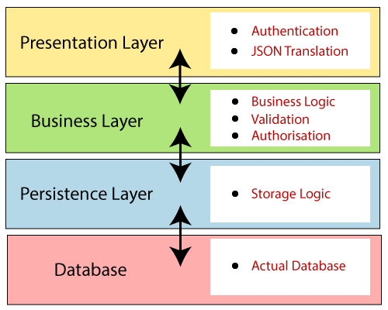
There are four layers in Spring Boot are as follows:
Presentation Layer
Business Layer
Persistence Layer
Database Layer

Slide 40
Presentation Layer:
The presentation layer handles the HTTP requests, translates the JSON parameter to an object, authenticates the request, and transfers it to the business layer.
In short, it consists of views i.e., the frontend part.
Business Layer:
The business layer handles all the business logic.
It consists of service classes and uses services provided by data access layers.
It also performs authorization and validation.

Slide 41
Persistence Layer:
The persistence layer contains all the storage logic and translates business objects from and to database rows.
Database Layer:
In the database layer, CRUD (create, retrieve, update, delete) operations are performed.

Slide 42

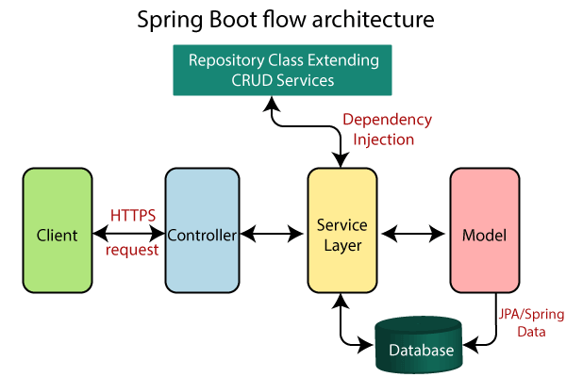

Slide 43
The architecture of Spring Boot is the same as the architecture of Spring MVC, except for one thing:
There is no need for DAO and DAOImpl classes in Spring boot.
Creates a data access layer and performs CRUD operation.
The client makes the HTTP requests (PUT or GET).
The request goes to the controller, and the controller maps that request and handles it. After that, it calls the service logic if required.
In the service layer, all the business logic performs. It performs the logic on the data that is mapped to JPA with model classes.

Slide 44
Spring Boot Framework
Day 6

Slide 45
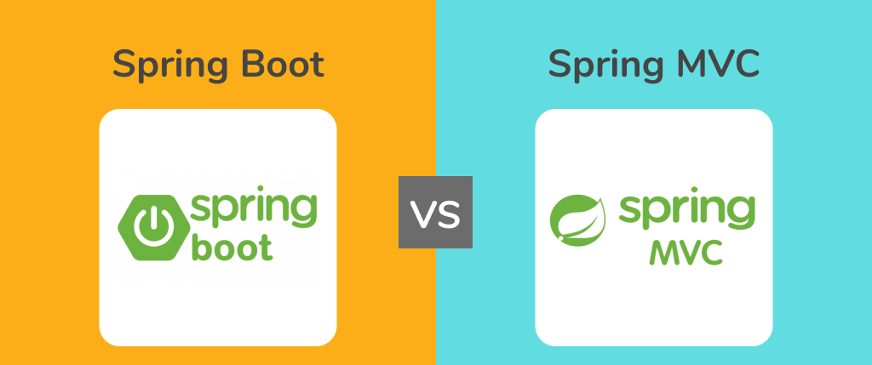

Slide 46
What is Spring MVC?
Spring MVC is a Java framework used to build web-based applications.
So, Spring MVC is an integrated version of the Spring framework and Model View Controller.
It has all the basic features of the core Spring framework like Dependency Injection and Inversion of Control.
The MVC pattern segregates the application’s different aspects (input logic, business logic, and UI logic) while providing a loose coupling between these elements.

Slide 47
The Model contains the core data of the application. In general, they consist of POJO (Plain Old Java Object).
The View is responsible for rendering the model’s data, and it generates HTML output that the client’s browser can interpret.
The Controller contains the business logic of the application.
Spring MVC is built around the Dispatcher Template that handles the HTTP requests and responses.

Slide 48
How does Spring MVC Works?
The client system sends an HTTP request to a specific URL.
Dispatcher Servlet, configured in the web.xml file, receives the request.
It then passes the request to a specific controller by finding it using Handler Mapping depending on the URL requested using @RequestMapping and @Controller annotations.
Spring MVC Controller executes the business logic and then returns a logical view name and model to Dispatcher Servlet.

Slide 49
Dispatcher Servlet consults view resolvers until the actual View is determined for rendering the output.
Dispatcher Servlet contacts the chosen view (like Excel, Freemarker, JSP) with model data, and it renders the output depending on the model data.
The provided output is returned to the client in the form of a response.

Slide 50
What is Spring Boot?
Spring Boot is another popular Java framework used for building applications.
It mainly focuses on creating standalone applications.
It is an extended version of the Spring framework that helps to reduce the development time.
The applications built using spring boot are enterprise-ready.
There are four layers in Spring boot;
Presentation layer
Business layer
Persistence layer
Database layer

Slide 51
The workflow goes like:
The client makes the HTTP requests.
This request goes to the controller, and the controller maps and handles it.
The request is passed on to the service layer where all the business logic is performed on the data that is mapped to JPA with model classes.
As a result, a response is returned to the user if no error occurred.

Slide 52
Spring Boot Framework
Day 7

Slide 53
How to create Spring Boot Application
How many ways to create a Spring boot application

Slide 54
Spring Initializer
Spring Boot STS IDE
Spring Boot CLI

Slide 55
Spring Annotations

Slide 56
@Required: It applies to the bean setter method.
It indicates that the annotated bean must be populated at configuration time with the required property, else it throws an exception BeanInitilizationException.
public class Machine
{
private Integer cost;
@Required
public void setCost(Integer cost)
{
this. cost = cost;
}
public Integer getCost()
{
return cost;
}
}

Slide 57
@Autowired :
Wires the application parts together, on the fields, constructors, or methods in a component.
@Component
public class Customer
{
private Person person;
@Autowired
public Customer(Person person)
{
this.person=person;
}
}

Slide 58
@ComponentScan:
Makes Spring scan the packages configured with it for the @Configuration classes.
@Configuration:
Used to mark a class as a source of the bean definition.
@ComponentScan(basePackages = "com.employee")
@Configuration
public class Test
{
// ...
}

Slide 59
@Bean:
Specifies a returned bean to be managed by spring context.
The returned bean has the same name as the factory method.
@Bean
public BeanExample beanExample()
{
return new BeanExample ();
}

Slide 60
@Component:
It is a class-level annotation.
Turns the class into a spring bean at the auto-scan time.
@Component
public class Student
{
.......
}

Slide 61
Spring Boot Annotations

Slide 62
@SpringBootApplication
A single @SpringBootApplication annotation is used to enable the following annotations:
@EnableAutoConfiguration: It enables the Spring Boot auto-configuration mechanism.
@ComponentScan: It scans the package where the application is located.
@Configuration: It allows us to register extra beans in the context or import additional configuration classes.

Slide 63
@Controller: The @Controller is a class-level annotation.
It is a specialization of @Component. It marks a class as a web request handler.
It is often used to serve web pages.
By default, it returns a string that indicates which route to redirect.
It is mostly used with @RequestMapping annotation.
@Controller
@RequestMapping("books")
public class BooksController
{
@RequestMapping(value = "/{name}", method = RequestMethod.GET)
public Employee getBooksByName()
{
return booksTemplate;
}
}

Slide 64
@Service:
It is also used at the class level. It tells the Spring that the class contains the business logic.
package com.java;
@Service
public class TestService
{
public void service1()
{
//business code
}

Slide 65
@Repository:
The repository is a DAOs (Data Access Object) that access the database directly.
The repository does all the operations related to the database.
package com.java;
@Repository
public class TestRepository
{
public void delete()
{
//persistence code
}
}

Slide 66
@RequestMapping: It is used to map web requests.
It has many optional elements like consumes, header, method, name, params, path, produces, and value.
We use it with the class as well as the method.
@Controller
public class BooksController
{
@RequestMapping("/computer-science/books")
public String getAllBooks(Model model)
{
//application code
return "bookList";
}

Slide 67
@GetMapping: It maps the HTTP GET requests on the specific handler method. It is used to create a web service endpoint that fetches It is used instead of using: @RequestMapping(method = RequestMethod.GET)
@PostMapping: It maps the HTTP POST requests on the specific handler method. It is used to create a web service endpoint that creates It is used instead of using: @RequestMapping(method = RequestMethod.POST)
@PutMapping: It maps the HTTP PUT requests on the specific handler method. It is used to create a web service endpoint that creates or updates It is used instead of using: @RequestMapping(method = RequestMethod.PUT)

Slide 68
@DeleteMapping:
It maps the HTTP DELETE requests on the specific handler method.
It is used to create a web service endpoint that deletes a resource.
It is used instead of using: @RequestMapping(method = RequestMethod.DELETE)
@RequestBody:
It is used to bind HTTP requests with an object in a method parameter.
Internally it uses HTTP Message Converters to convert the body of the request.
When we annotate a method parameter with @RequestBody,
The Spring framework binds the incoming HTTP request body to that parameter.

Slide 69
@ResponseBody: It binds the method return value to the response body. It tells the Spring Boot Framework to serialize a return an object into JSON and XML format.
@PathVariable: It is used to extract the values from the URI. It is most suitable for the RESTful web service, where the URL contains a path variable. We can define multiple @PathVariable in a method.
@RestController:
It can be considered as a combination of @Controller and @ResponseBody annotations.
The @RestController annotation is itself annotated with the @ResponseBody annotation.
It eliminates the need for annotating each method with @ResponseBody.

Slide 70
Spring Boot Framework
Day 8

Slide 71
Spring Boot Application Properties:
Spring Boot Framework comes with a built-in mechanism for application configuration using a file called application.properties.
It is located inside the src/main/resources folder.
Spring Boot provides various properties that can be configured in the application.properties file.
The properties have default values. We can set a property(s) for the Spring Boot application.
Spring Boot also allows us to define our own property if required.

Slide 72
Example of application.properties
#configuring application name
spring.application.name = demoApplication
#configuring port
server.port = 8081

Slide 73
YAML Properties File
Spring Boot provides another file to configure the properties is called yml file.
The Yaml file works because the Snake YAML jar is present in the classpath.
Instead of using the application.properties file
we can also use the application.yml file, but the Yml file should be present in the classpath.

Slide 74
Example of application.yml
spring:
application:
name: demo Application
server:
port: 8081

Slide 75
Spring Boot Property Categories:
There are sixteen categories of Spring Boot Property are as follows:
Core Properties
Cache Properties
Mail Properties
JSON Properties
Data Properties
Transaction Properties
Data Migration Properties
Integration Properties
Web Properties
Templating Properties
Server Properties
Security Properties
RSocket Properties
Actuator Properties
DevTools Properties
Testing Properties

Slide 76
Spring Boot Framework
Day 9

Slide 77
Spring Boot Rest Concept

Slide 78
All kinds of applications can be designed using spring boot .
For web applications spring boot provides built in web servers (tomcat) .
Spring boot is openionated .
Many things are auto configured . Each application can have its own server

Slide 79
Rest : - Representational state transfer Data received from the server depends on URL.
URL represents a particular page Whenever we change URL display to a new page.
Data formats : XML format
JSON format

Slide 80
XML Format :
<employee>
<empId> 100 </empId>
<empName> 'saddam’ </empName>
</employee>
XML file is quite bulky that’s why using JSON

Slide 81
JSON Format : Java script object notation
Single Object : { "emp Id " : 10,"name" : " saddam " }
Multiple Object : [
{ "emp Id " : 10,"name" : " saddam " }
{ "emp Id " : 20,"name" : " Hussain " }
{ "emp Id " : 30,"name" : " Naveen " }
]

Slide 82
How to create spring boot rest application project ?
create spring boot starter project with following dependencies
spring web
dev tools

Slide 83
spring web is using means we are seeing the data in web pages based on URL
spring boot dev tools whenever makes the changes in code we can save the code that's it automatic restart the code without using the stopping process
This is the advantages of spring boot dev tool

Slide 84
Spring Boot Framework
Day 10

Slide 85
Basic Spring Boot Application creation
Video Link : https://youtu.be/domBd8sNowc

Slide 86
Spring Boot with Lombok Dependency Advantages
Video Link : https://youtu.be/sbnXhixqY3I

Slide 87
Difference between @Pathvariable and @RequestParam Annotations
Video Link : https://youtu.be/Ghd8llQ9mD8

Slide 88
Spring Boot Framework
Day 11

Slide 89
Spring Boot Data JPA

Slide 90
Create Entity classes with annotations
@Entity
@Id
@OneToOne
@OneToMany etc.,
we need to provide database details in application.properties file

Slide 91
Create repository interface and extending below interfaces.
Crud repository interface
Jpa repository interface(which provide all jpa methods)

Slide 92
Spring fox swagger
swagger is a documentation tool for rest application
swagger provides excellent UI for testing rest application spring boot does not provide swagger dependency

Slide 93
we need to add the swagger 2 and swagger dependencies
add @EnableSwagger2 annotation to the main class
with swagger we can test rest application using any normal browser

Slide 94
url's :
http://localhost:port number/v2/api-docs
http://localhost:port number/swagger-ui-html
We can use postman or swagger anything

Slide 95
Spring Boot Framework
Day 12

Slide 96
Spring Boot exception handling

Slide 97
@controllerAdvice :- It is the class which handles all the Global exceptions in the application.
It can have methods to handle different exceptions.
When exception happen or occurs anywhere in the application controller advice is handling.
In controller advice class we need to write @ExceptionHandler(Studentnotfoundexception.class) annotation in each method.

Slide 98
Spring Boot data validation

Slide 99
Spring data validation :-
check the data sent by the client.
Client sends the data in Json format.
Json is translated into Java object in the controller.
While translating we need to check the data.

Slide 100
Steps :-
add validation dependency.
use validation annotations in entity classes.
In the controller use @ valid annotation along with @RequestBody.
@Valid annotation makes it possible to check the validation errors.
If validation fails method argument not valid exception is thrown.
Controller advice should handle these exception

Slide 101
Exception Handling and Data validation
Video link : https://youtu.be/cPbNppp-9rs

Slide 102
Spring Boot Framework
Day 13

Slide 103
Spring Boot Starter Actuator

Slide 104
Spring Boot Actuator is a sub-project of the Spring Boot Framework.
It includes a number of additional features that help us to monitor and manage the Spring Boot application.
It contains the actuator endpoints (the place where the resources live).

Slide 105
We can use HTTP and JMX endpoints to manage and monitor the Spring Boot application.
If we want to get production-ready features in an application, we should use the Spring Boot actuator.
Spring Boot Actuator Features
There are three main features of Spring Boot Actuator:
Endpoints
Metrics
Audit

Slide 106
Endpoint:
The actuator endpoints allows us to monitor and interact with the application.
Spring Boot provides a number of built-in endpoints. We can also create our own endpoint.
We can enable and disable each endpoint individually.
Most of the application choose HTTP, where the Id of the endpoint, along with the prefix of /actuator, is mapped to a URL.
For example, the /health endpoint provides the basic health information of an application.
The actuator, by default, mapped it to /actuator/health.

Slide 107
Metrics:
Spring Boot Actuator provides dimensional metrics by integrating with the micro meter.
The micro meter is integrated into Spring Boot.
It is the instrumentation library powering the delivery of application metrics from Spring.
It provides vendor-neutral interfaces for timers, gauges, counters, distribution summaries, and long task timers with a dimensional data model.

Slide 108
Audit:
Spring Boot provides a flexible audit framework that publishes events to an AuditEventRepository.
It automatically publishes the authentication events if spring-security is in execution.

Slide 109
Enabling Spring Boot Actuator
We can enable actuator by injecting the dependency spring-boot-starter-actuator in the pom.xml file.
<dependency>
<groupId>org.springframework.boot</groupId>
<artifactId>spring-boot-starter-actuator</artifactId>
<version>2.2.2.RELEASE</version>
</dependency>

Slide 110
Id | Usage | Default
actuator | It provides a hypermedia-based discovery page for the other endpoints. It requires Spring HATEOAS to be on the classpath. | True
auditevents | It exposes audit events information for the current application. | True
autoconfig | It is used to display an auto-configuration report showing all auto-configuration candidates and the reason why they 'were' or 'were not' applied. | True
beans | It is used to display a complete list of all the Spring beans in your application. | True
configprops | It is used to display a collated list of all @ConfigurationProperties. | True
dump | It is used to perform a thread dump. | True
env | It is used to expose properties from Spring's ConfigurableEnvironment. | True
flyway | It is used to show any Flyway database migrations that have been applied. | True
health | It is used to show application health information. | False
info | It is used to display arbitrary application info. | False
loggers | It is used to show and modify the configuration of loggers in the application. | True
liquibase | It is used to show any Liquibase database migrations that have been applied. | True
metrics | It is used to show metrics information for the current application. | True
mappings | It is used to display a collated list of all @RequestMapping paths. | True
shutdown | It is used to allow the application to be gracefully shutdown. | True
trace | It is used to display trace information. | True

Slide 111
For Spring MVC, the following additional endpoints are used.
Id | Description | Default
docs | It is used to display documentation, including example requests and responses for the Actuator's endpoints. | False
heapdump | It is used to return a GZip compressed hprof heap dump file. | True
jolokia | It is used to expose JMX beans over HTTP (when Jolokia is on the classpath). | True
logfile | It is used to return the contents of the logfile. | True
prometheus | It is used to expose metrics in a format that can be scraped by a prometheus server. It requires a dependency on micrometer-registry- prometheus. | True

Slide 112
Spring Boot Framework
Day 14

Slide 113
Application . properties file
v/s
Application . yml file

Slide 114
Application . properties file :
Data is stored in key-value fashion.
Sequential format
Advantages :
Easy to modify
Disadvantages :
Repetition in keys
On increase in properties file, it becomes difficult to understand the keys and value.

Slide 115
Application . yml file :
Yml stands for yet another markup language.
Stores data in key-value pair fashion.
Hierarchical format.
Advantages :
Easy to modify.
Easy to understand as it follows hierarchical approach
No repetitions in keys.
Multi language support like java, python etc.,
We can have array, list, and map also in yaml.
Disadvantages :
Complex indentation formatting.

Slide 116
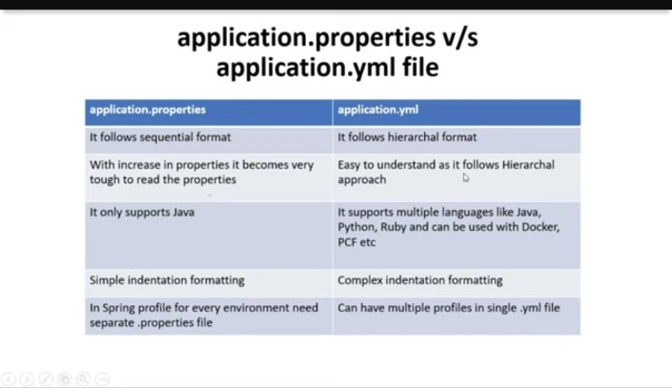

Slide 117
Spring Boot Framework
Day 15

Slide 118
@Qualifier vs @Primary Annotations with Examples

Slide 119
We can use @Qualifier and @Primary for the same bean.
Use @Qualifier to inject specific bean otherwise Spring injects bean by default which is annotated with @Primary

Slide 120
Let us create an interface University,
University.java
package com.easy;
public interface University {
public String display();
}

Slide 121
Now this university is implemented by couple of services, Alpha University and Beta University
AlphaUniversity.java
package com.easy.service;
import com.easy.University;
import org.springframework.stereotype.Service;
@Service
public class AlphaUniversity implements University {
@Override
public String display() {
return "This is a message from Alpha University";
}
}

Slide 122
BetaUniversity
package com.easy.service;
import com.easy.University;
import org.springframework.stereotype.Service;
@Service
public class BetaUniversity implements University {
@Override
public String display() {
return "This is a message from Beta University";
}
}

Slide 123
Now let us have a controller,
UniversityController.java
package com.easy.controller;
import com.easy.University;
import org.springframework.beans.factory.annotation.Autowired;
import org.springframework.web.bind.annotation.GetMapping;
import org.springframework.web.bind.annotation.RestController;
@RestController
public class UniversityController {
@Autowired
private University university;
@GetMapping ("/university")
public String getUniversity() {
return university.display();
}
}

Slide 124
Now when we call “/univeristy” API which dependency will be actually called?
will it be Alpha University or Beta University?

Slide 125
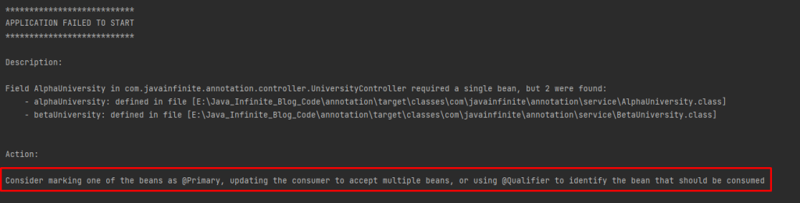

Slide 126
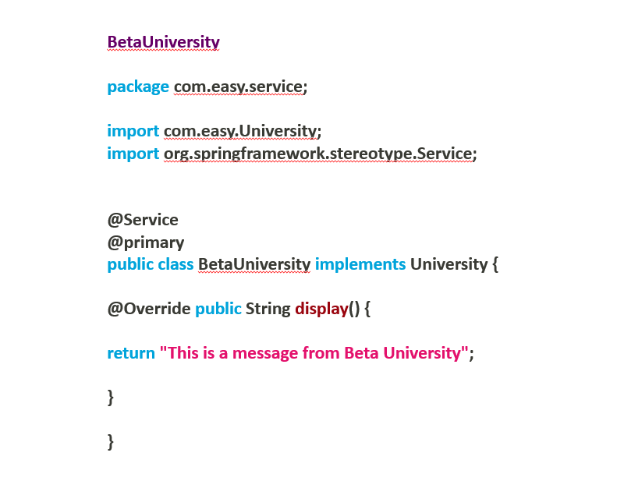

Slide 127
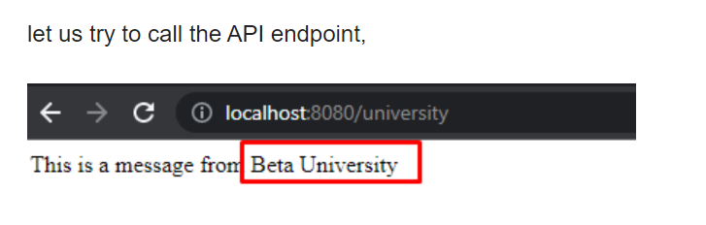

Slide 128
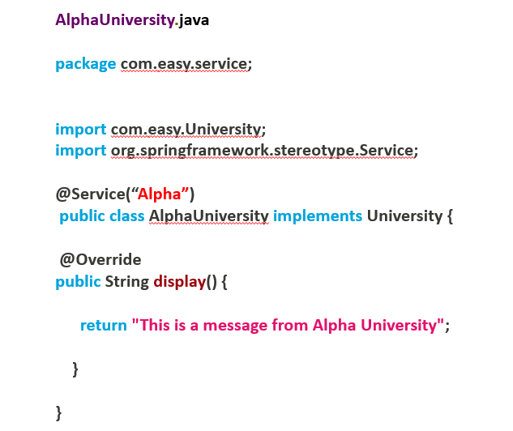
Spring boot has considered BetaUniversity as a preferred bean when University is Autowired.
Now let us use @Qualifier annotation to differentiate beans,

Slide 129
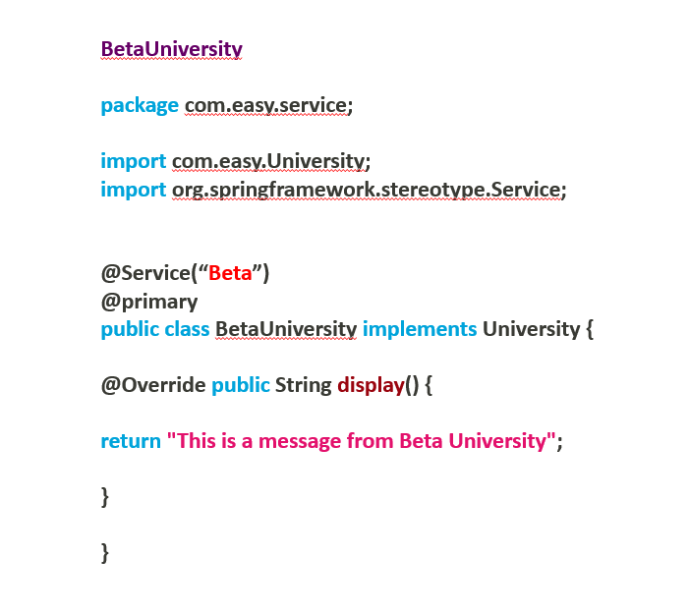

Slide 130
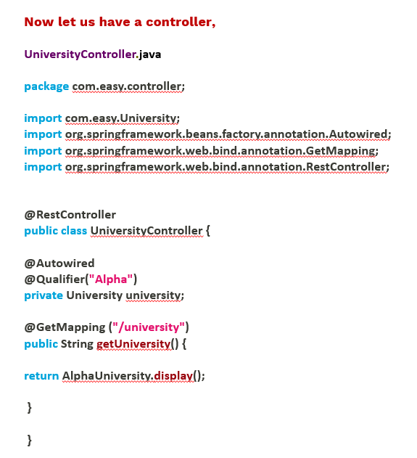

Slide 131
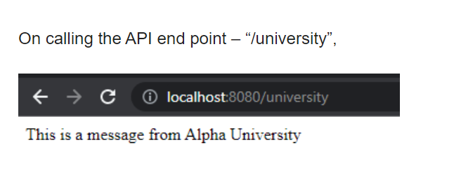

Slide 132
Which is of higher priority @Primary or @Qualifier?
@Qualifier has higher priority than @Primary annotation. In the above example we have used both @Primary and @Qualifier together – Qualifier has taken higher priority than @Primary.
Can we declare both @Primary and @Qualifier together?
Yes, Both annotations can be used together but only one can be executed at a time. (Qualifier first, if qualifier not present it will execute primary)

Slide 133
Spring Boot Framework
Day 16

Slide 134
How to Use Profiles in Spring Boot?

Slide 135
What Are Profiles?
Every enterprise application has many environments, like:
Dev | Test | Acceptance | Production
Each environment requires a setting that is specific to them. For example, in DEV, we do not need to constantly check database consistency.
Whereas in Test and Acceptance, we need to. These environments host specific configurations called Profiles.

Slide 136
How to Use Profiles in Spring Boot?
Video link : https://youtu.be/P4GPBpLhOug

Slide 137
Spring Boot Framework
Day 17

Slide 138
One-to-One Uni-directional
Mapping in Spring Boot

Slide 139
One-to-One Uni-directional Mapping
Table 1
Table 2
EmpId | EmpName | TaskId
1 | Naveen | 8
2 | Hussain | 7
TaskId | Task
7 | Login issues
8 | Registration issues

Slide 140
Video link : https://youtu.be/JJwTNUPDSYE

Slide 141
Spring Boot Framework
Day 18

Slide 142
One-to-One Bi-directional
Mapping in Spring Boot

Slide 143
One-to-One Bi-directional Mapping
Emp Table
Task Table
EmpId | EmpName | TaskId
1 | Naveen | 8
2 | Hussain | 7
TaskId | Task
7 | Login issues
8 | Registration issues
Emp-Task Table
EmpId | TaskId
1 | 8
2 | 7

Slide 144
Video link : https://youtu.be/5ZZtdKghuiM

Slide 145
Spring Boot Framework
Day 19

Slide 146
One-to-Many Uni-directional
Mapping in Spring Boot

Slide 147
One-to-Many Mapping
Task Table
Emp Table
TaskId | TaskName | EmpId
1 | UI related issues | 1
2 | Login related issues | 1
3 | Registration related issues | 1
4 | Deployment issues | 2
5 | Infrastructure issues | 2
EmpId | EmpName
1 | Saddam Hussain
2 | Naveen

Slide 148
Video link : https://youtu.be/irbKoEK5Gd0

Slide 149
Spring Boot Framework
Day 20

Slide 150
Many-to-One Bi-directional
Mapping in Spring Boot

Slide 151
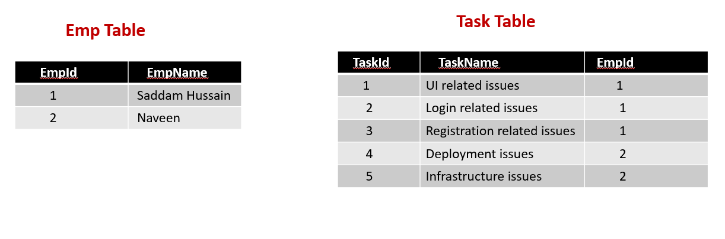
Many-To-One Bi-directional Mapping

Slide 152
Video link : https://youtu.be/dO9una6QqvY

Slide 153
Spring Boot Framework
Day 21

Slide 154
Many-to-Many Uni-directional
Mapping in Spring Boot

Slide 155
Customer Table
Item Table
Customer_Id | Customer_Name
1 | Saddam Hussain
4 | Naveen
6 | Sagar
Item_Id | Items
2 | Mobile
3 | Laptop
5 | Earphones
7 | Mouse
8 | Headset
Customer Item Table
Customer_Id | Item_Id
1 | 2
1 | 3
4 | 5
6 | 7
6 | 8

Slide 156
Video link : https://youtu.be/7AA7-h7oLlM

Slide 157
Spring Boot Framework
Day 22

Slide 158
Many-to-Many Bi-directional
Mapping in Spring Boot

Slide 159
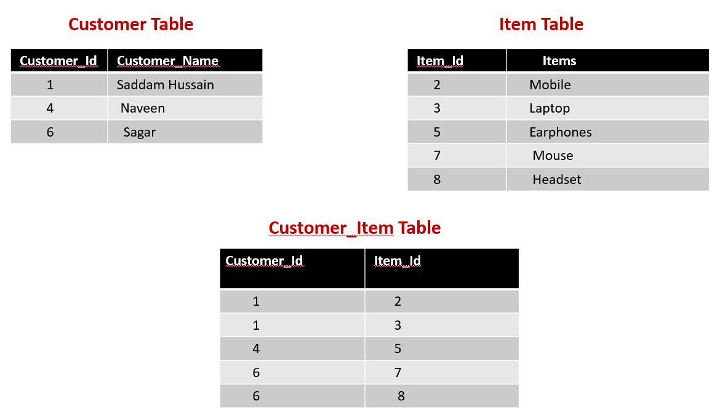

Slide 160
Video link : https://youtu.be/sus8Z7Nha7c

Slide 161
Spring Boot Framework
Day 23

Slide 162
Project Deployment Using Tomcat Server

Slide 163
Setting up a Spring Boot Application
Create a Spring Boot WAR
Deploy the WAR to Tomcat

Slide 164
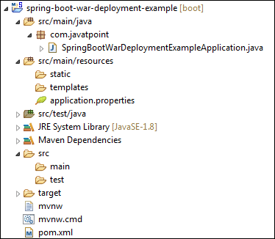
Setting up a Spring Boot Application

Slide 165
Create a Spring Boot WAR
Extends the SpringBootServletInitializer class in the main class.
Marked the embedded servlet container as provided.
Override the Configure method.
@Override
protected SpringApplicationBuilder configure(SpringApplicationBuilder application)
{
return application.sources(SpringBootWarDeploymentExampleApplication.class);
}

Slide 166
Update packaging JAR to WAR
Modify the final WAR file name by using the <finalName> tag to avoid including the version numbers.
We have created a WAR file with the name web-services.
<finalName>web-services</finalName>

Slide 167
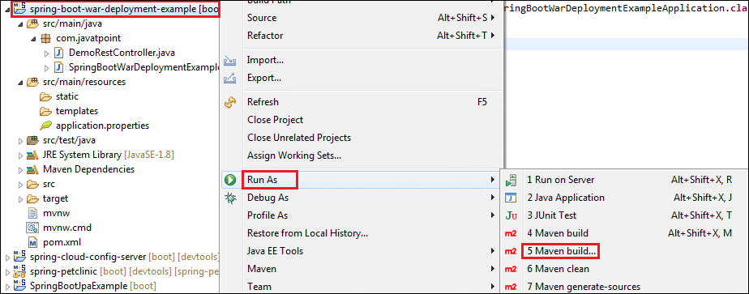
Create a WAR file by using the following steps:
Right-click on the project -> Run As -> 5 Maven Build

Slide 168
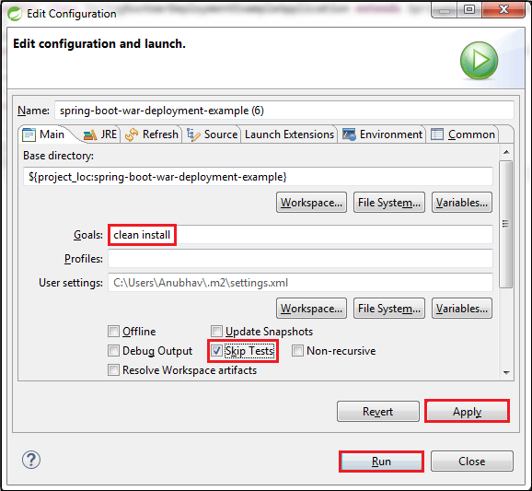

Slide 169
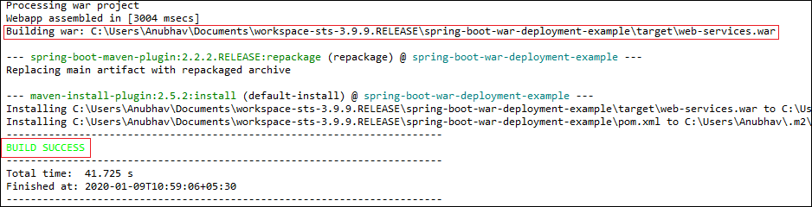
When the WAR file successfully created, it shows the WAR file path and a message BUILD SUCCESS in the console, as shown in the following figure.

Slide 170
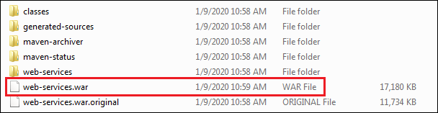
Copy the path and access the target folder of the application.
We found the WAR file inside the target folder with the same name as we have specified in the pom.xml file.

Slide 171
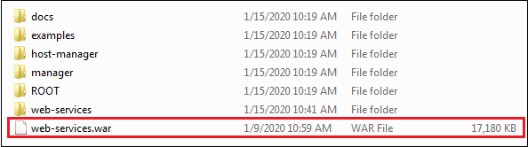
Deploy the WAR file to Tomcat
To deploy the WAR file, follow the steps below:
Download and install the Apache Tomcat Server, if not installed.
Copy the WAR file (web-services.war) and paste it inside the webapps folder of the Tomcat. In our case, the location of the webapps folder is:

Slide 172
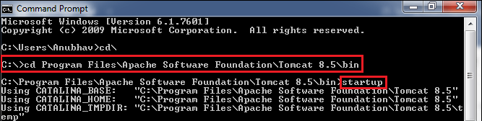
Now open the Command Prompt and type the following commands:
C:\Cd Program Files\Apache Software Foundation\Tomcat 8.5\bin
C:\Cd Program Files\Apache Software Foundation\Tomcat 8.5\bin>startup

Slide 173
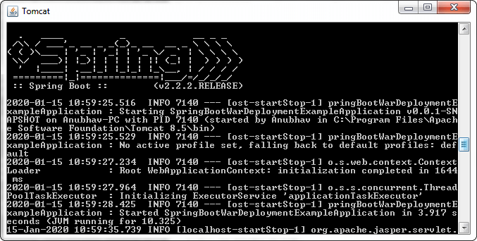


Slide 174
Open the browser and invoke the URL http://localhost:8080/web-services/hello.
It returns the message

